Slide 1
Weather & Forecasting for Cross Country Soaring
Brian Resor
Albuquerque Soaring Club - Moriarty, NM

Slide 2
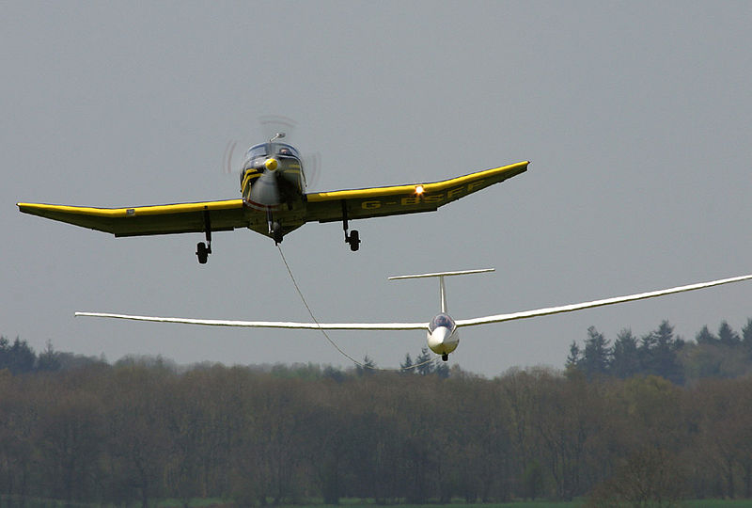
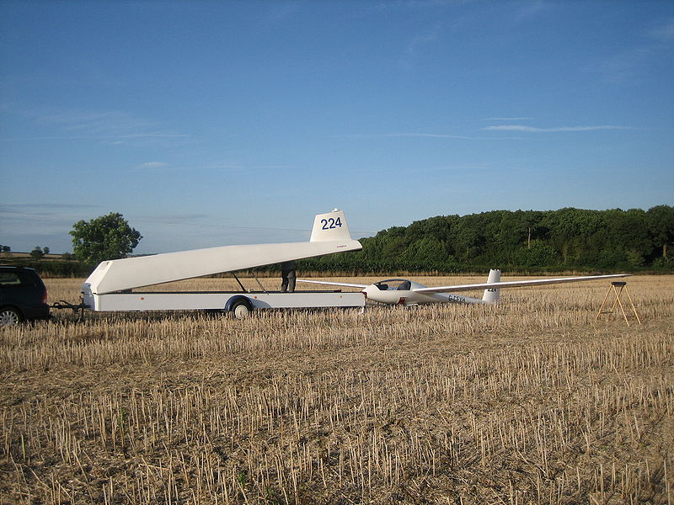
Sailplanes/Gliders
Get into the air by
Aerotowing on a 200ft rope
Typical release height 2k AGL
Have all the control authority of a powered aircraft
Have radios and avionics (GPS)
Are always sinking through the air in order to maintain forward speed
Utilize updrafts in the atmosphere to stay aloft
Thermals, ridge, wave
Are not affected if “the wind quits” (with a few exceptions)

Slide 3
Outline
Define cross country soaring
Define soaring weather
Resources for soaring weather
Forecasting soaring weather
Examples of special weather

Slide 4
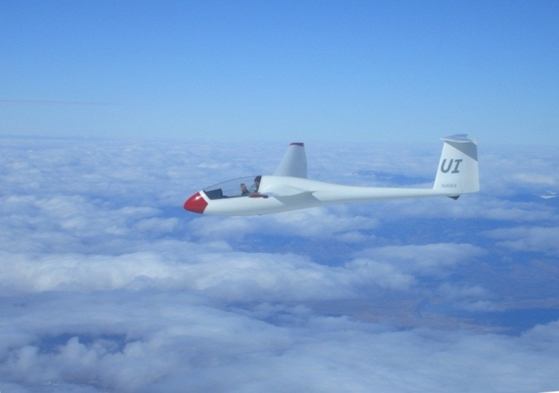
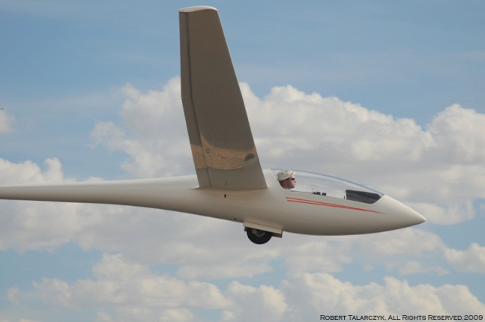
My forecasting background
Formal education
BS/MS Mechanical Engineering; Currently working in wind turbine aeroelasticity
Self study
Understanding The Sky by Dennis Pagen; Meteorology and Flight, 3rd ed. by Tom Bradbury
Daily NWS Forecast Discussions
Flight experience
Soaring since 1998; Over 20,000 cross country miles in PA, FL, AZ, CO and NM
Forecaster for NM contests
2009 1-26 Nationals
2011 Moriarty Super Regionals
2012 Moriarty Super Regionas

Slide 5
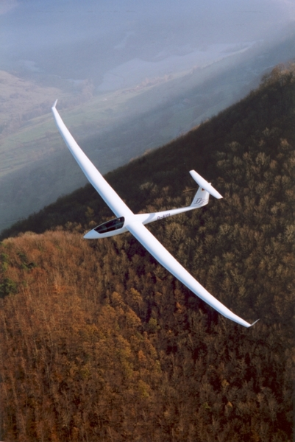
Definition of cross country soaring
Unpowered flights venturing beyond glide range of the home airport
Requires locating sources of lift along the route
Requires detailed understanding of weather over a large domain of space and time
Typical sailplane glide ratio is 40 to 1
In most cases, when you are more than 40 miles away from home, you are “cross country”
In the U.S. in 2011 there were approximately 1.8M cross country miles flown by approximately 1,000 pilots (OLC Stats)

Slide 6
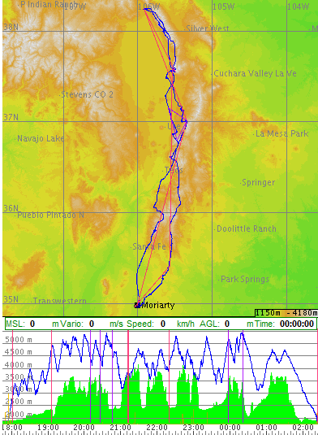
An epic cross country adventure
Spring 2011
Moriarty, NM to Salida, CO
700 km (435 smi)
Convergence, Cu, blue, ridge lift, multiple airmasses
Use of the entire soaring day!

Slide 7
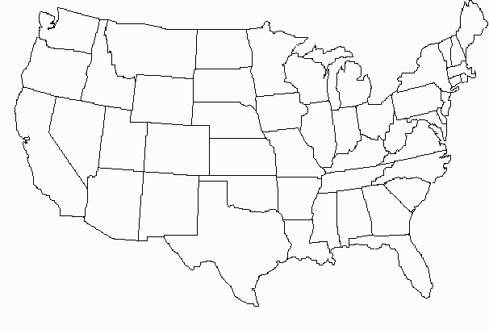
Soaring in the United States
Gliding operations
Known contest sites
Popular corridors

Slide 8
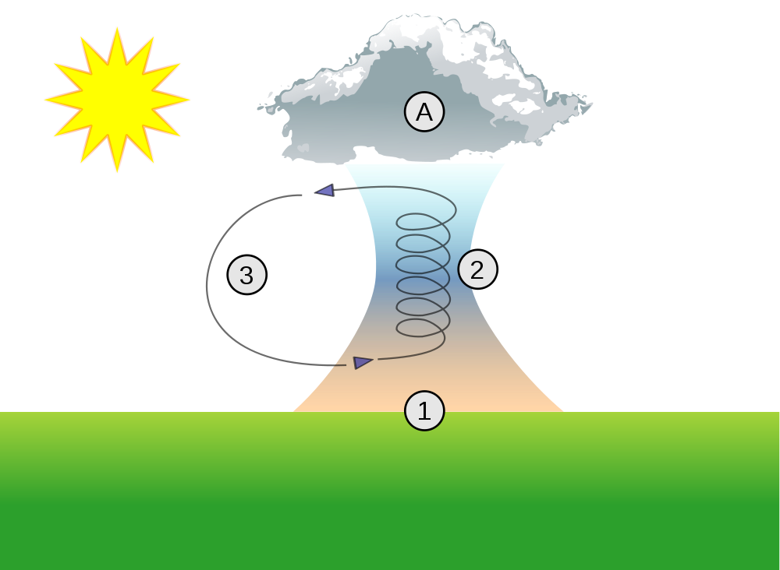
Definition of a great soaring day
Unstable convective boundary layer
Thickness of 5-6k AGL - higher is better
Light winds of 15kt or less, minimal shear or gradients
Adequate moisture for fair weather Cu – but not so much to cause too much rain, overdevelopment, or storms
Consistent conditions starting in late morning and lasting until sunset
The vast majority of soaring occurs in spring, summer and autumn thermals

Slide 9
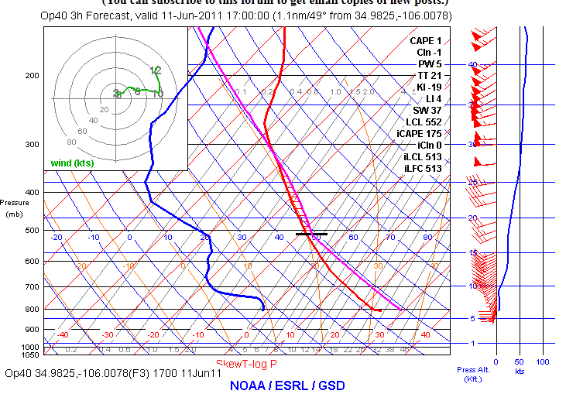
SkewT-logP
Forecast soundings From the FSL webpage:
Climb height
Cloudbase (if any)
Wind speed
& direction
Wind shear
Moisture
profile
Trigger temperature

Slide 10
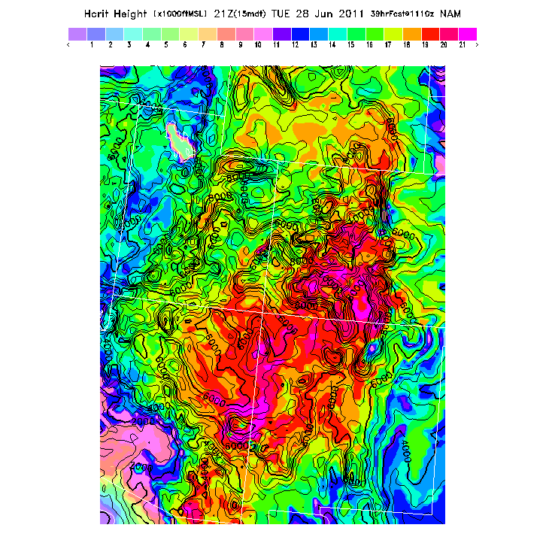
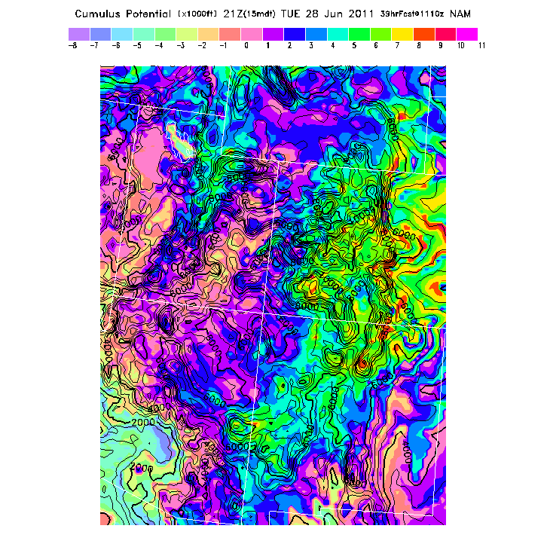
BLIPMAPS Dr. John W. (Jack) Glendening
http://www.drjack.info/BLIP/

Slide 11
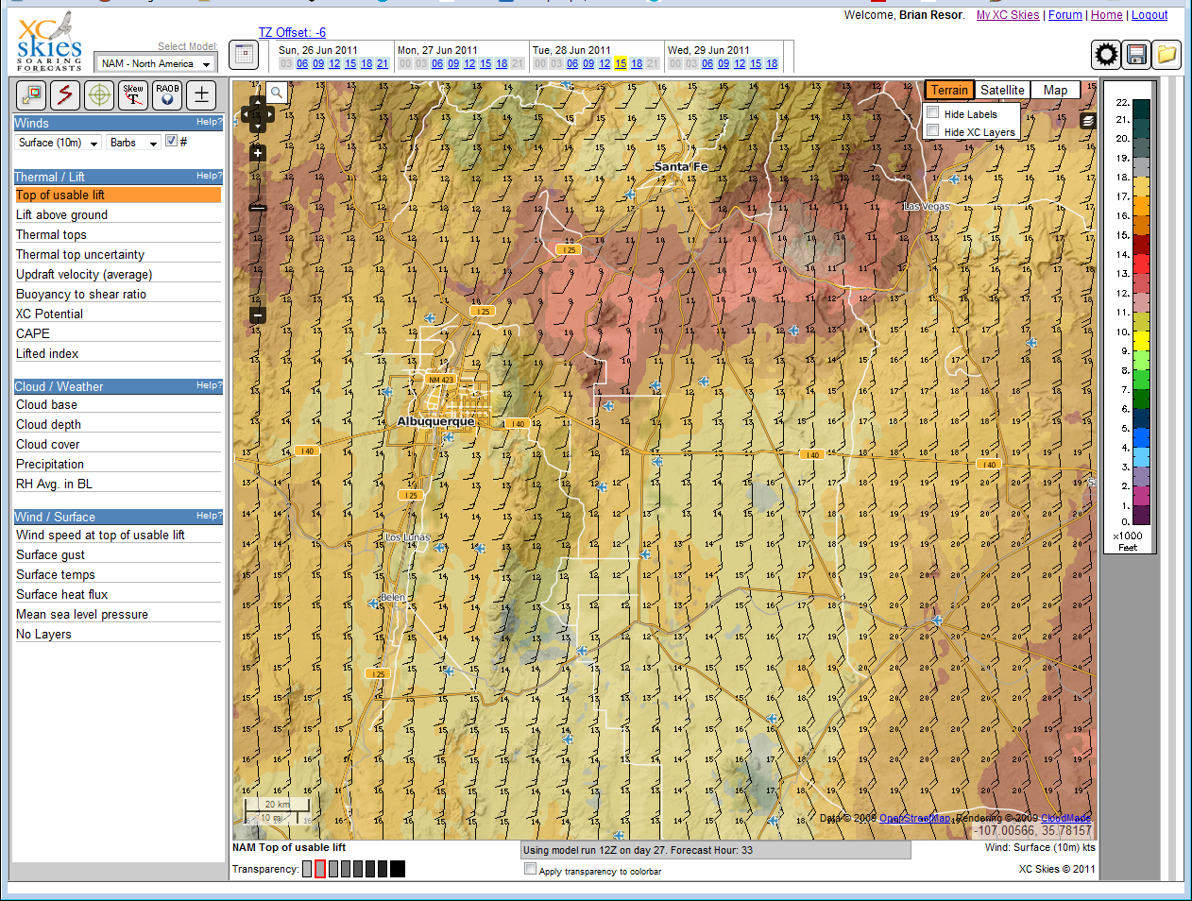
www.xcskies.com

Slide 12
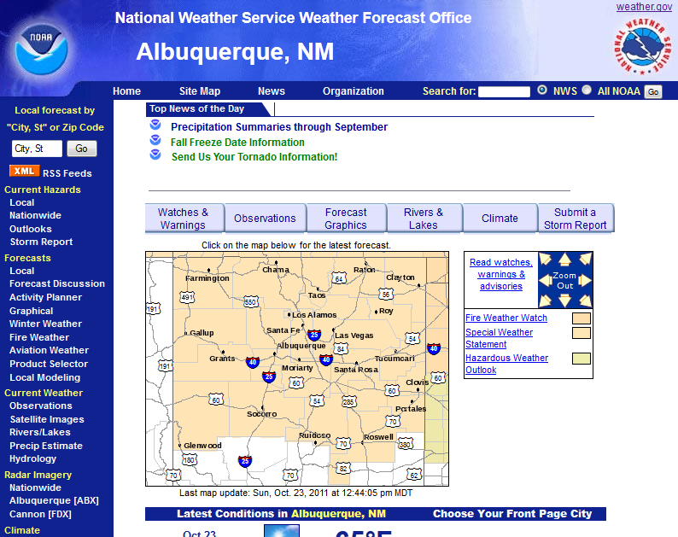
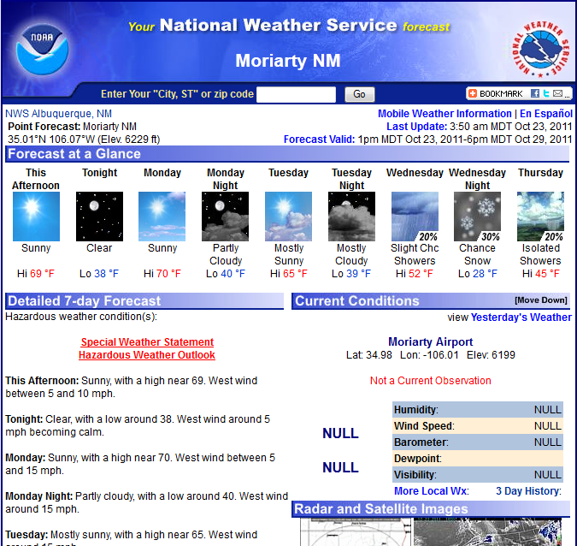
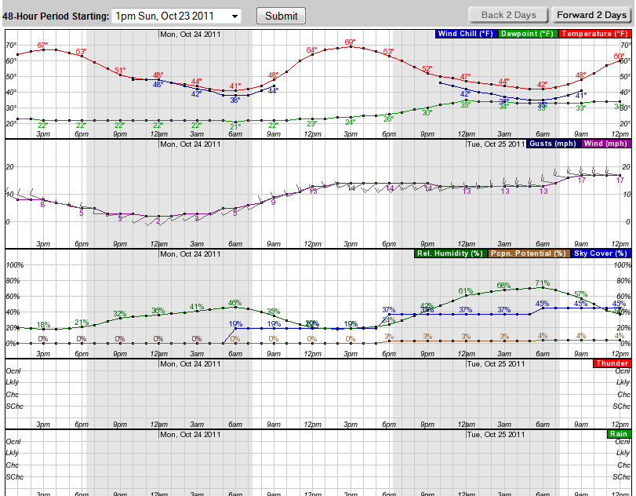
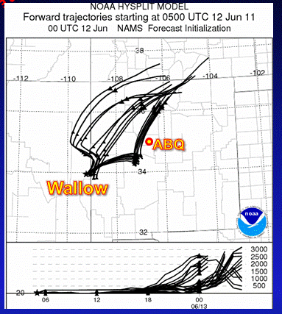
Local NWS internet resources

Slide 13
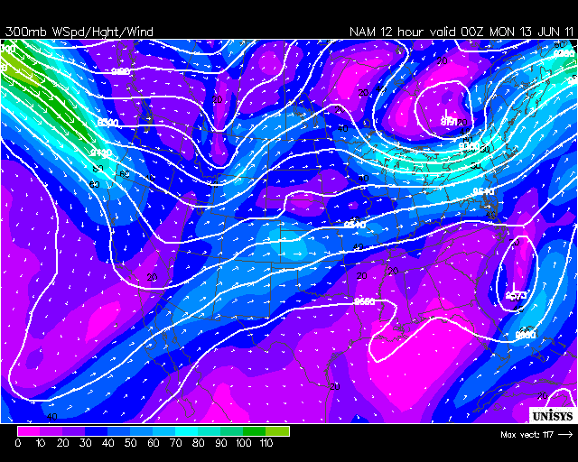
5+ days out
NWS simple daily description: moisture, high temp and winds
Read the forecast discussion
300mb forecast charts (Jet)

Slide 14
2-3 days out
NWS simple daily description: moisture, high temp and winds
Read the forecast discussion
300mb forecast charts (Jet)
NWS Hourly weather graphs
BLIPMAPS – NAM forecast model

Slide 15
Day of flight
NWS simple daily description: moisture, high temp and winds
Read the forecast discussion
Check hourly weather graphs as needed
Study BLIPMAPS
NWS Hourly weather graphs
Study the Java-based forecast sounding
Check visible satellite and water vapor images

Slide 16
The goal
Pilots want to walk away from a briefing with ACCURATE:
Thermal heights and type of clouds, if any
Winds at surface and aloft
Expected average climb rates
Sense of how the day will develop – good or bad

Slide 17
Special conditions
Convergence
Wave

Slide 18
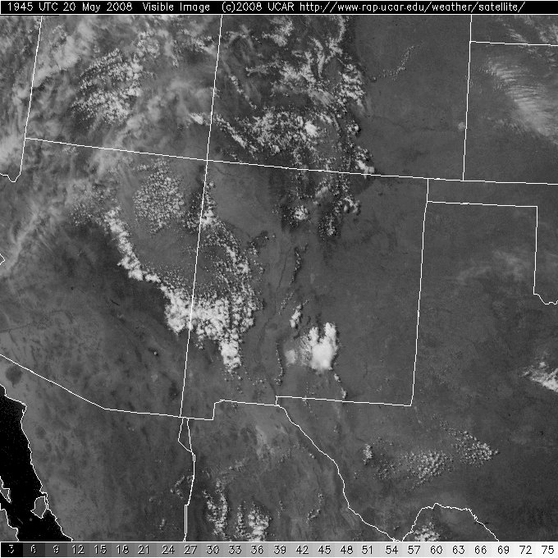
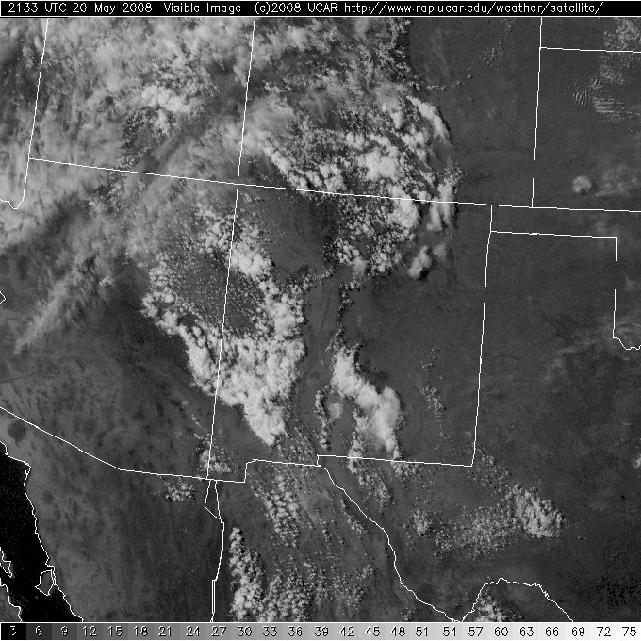
Central Mountains Convergence
Satellite images – 1:45 and 3:33pm

Slide 19
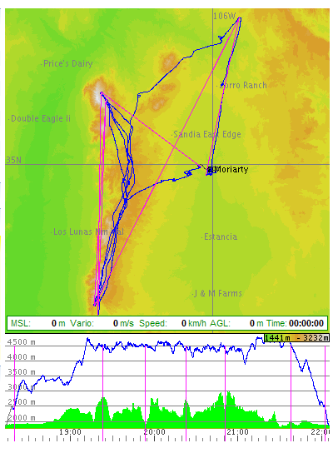
Convergence Cartoon Where To Fly
Central Mountains
Valencia
Chilili
Moriarty

Slide 20
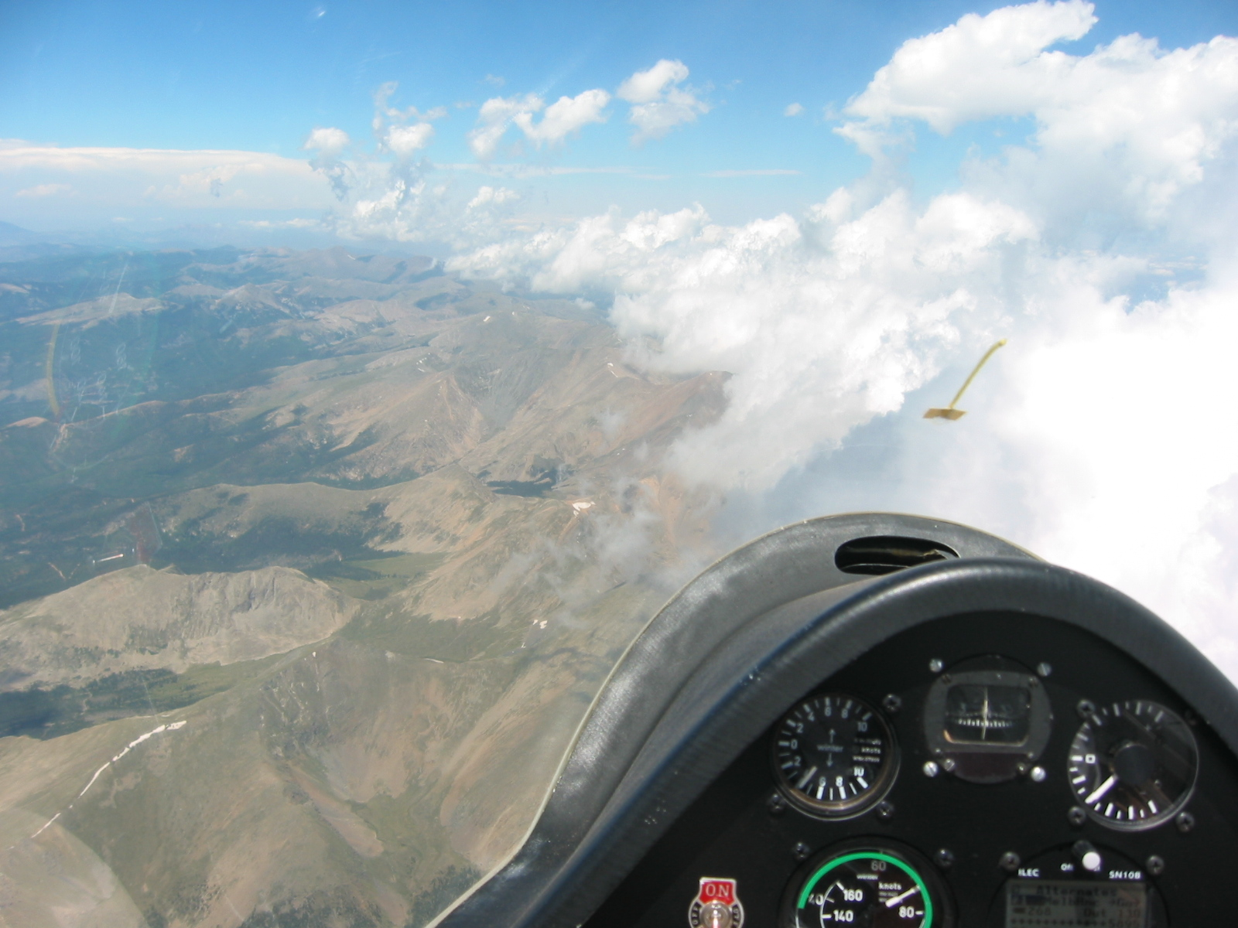

Culebra Range Convergence (Colorado)

Slide 21
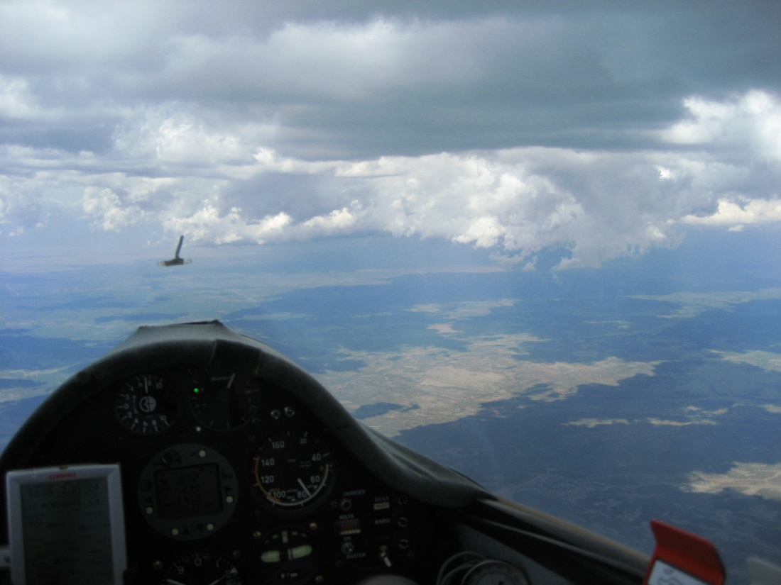
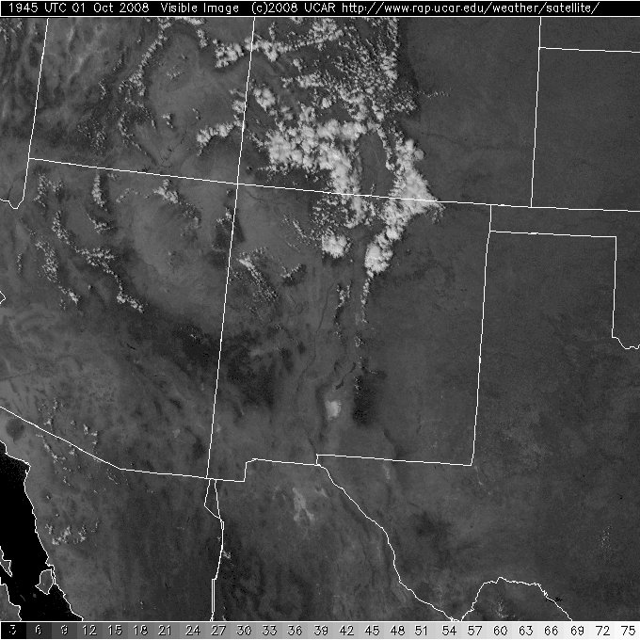
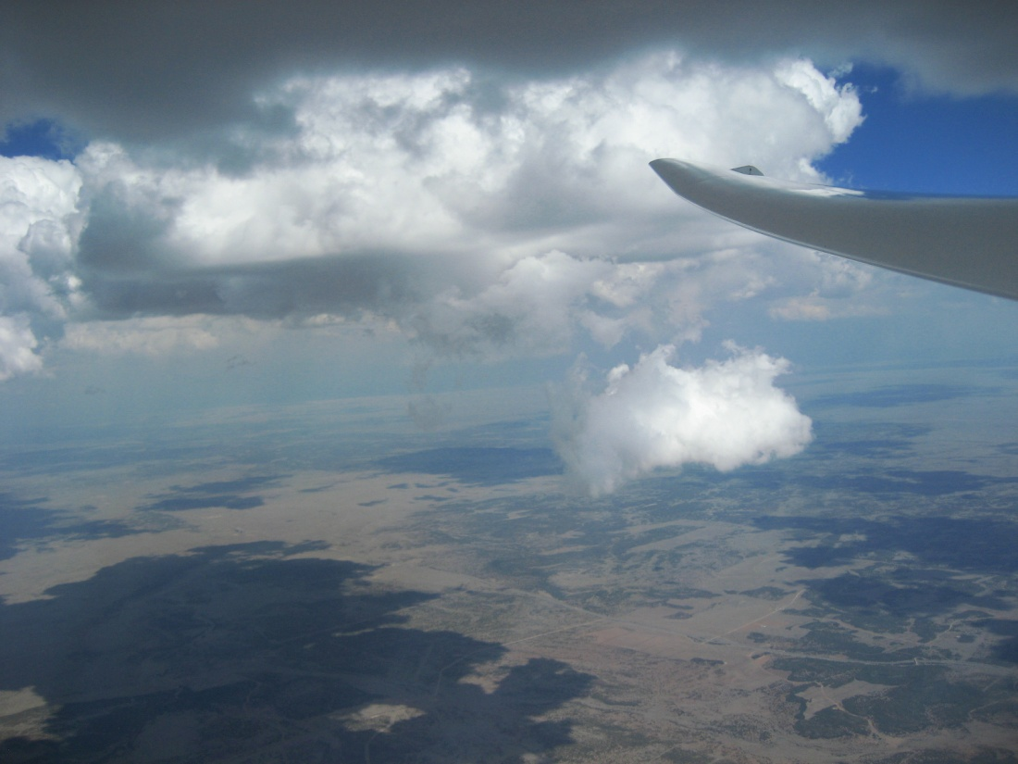
US 285 Dryline Convergence

Slide 22
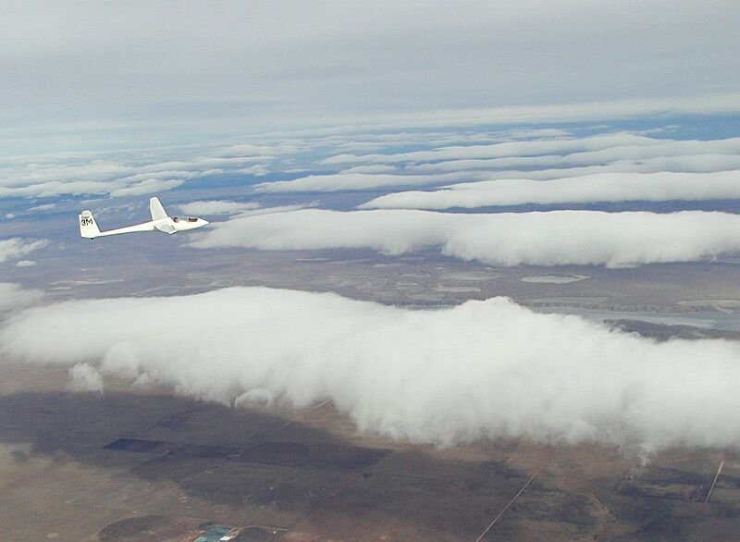
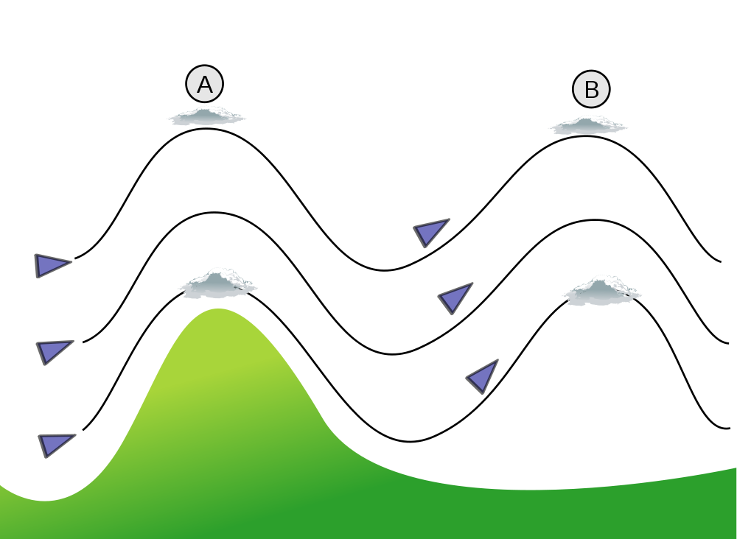
Mountain (Lee) Wave
Typically limited to late fall, winter, and early spring

Slide 23
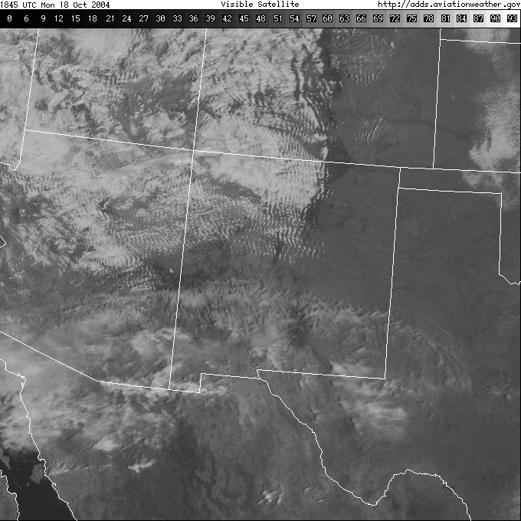
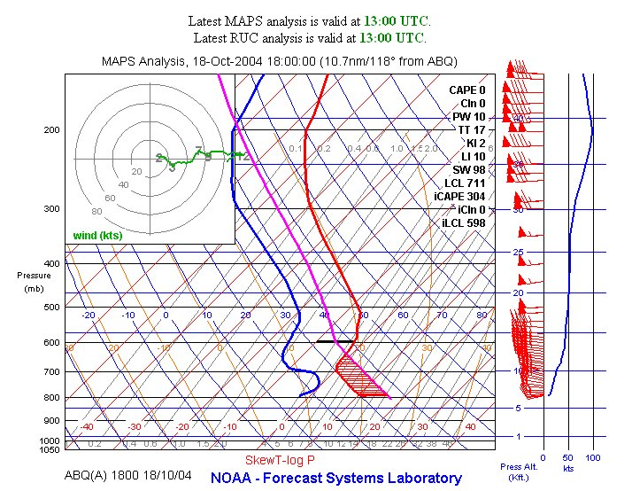
Perfect wave day
Winds aloft ~30-50kt

Slide 24
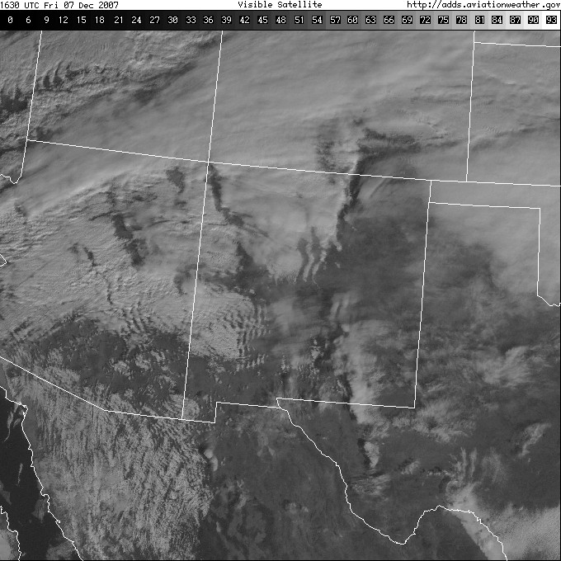
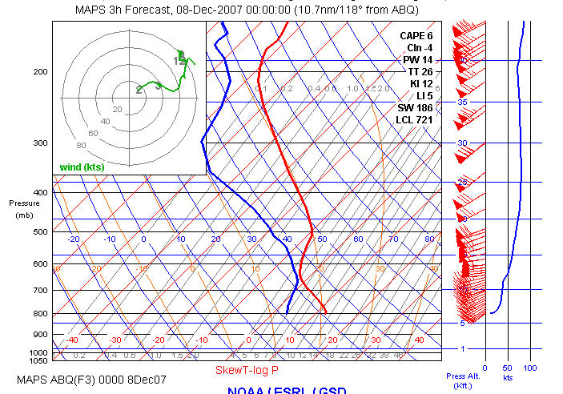
A difficult day
High winds aloft: >70kt

Slide 25
Online resources
Albuquerque NWS: big picture, short description, high temp, surface winds, hourly graphs, forecast discussion, dewpoint, radar | http://www.srh.noaa.gov/abq
Visible satellite, radar, prognostic charts, winds/temps | http://www.aviationweather.gov/adds
Java-based forecast sounding charts | http://www-frd.fsl.noaa.gov/mab/soundings
300mb forecast charts | http://weather.unisys.com
BLIPMAPS | http://www.drjack.info/BLIP
XC-Skies | http://www.xcskies.com

Slide 26
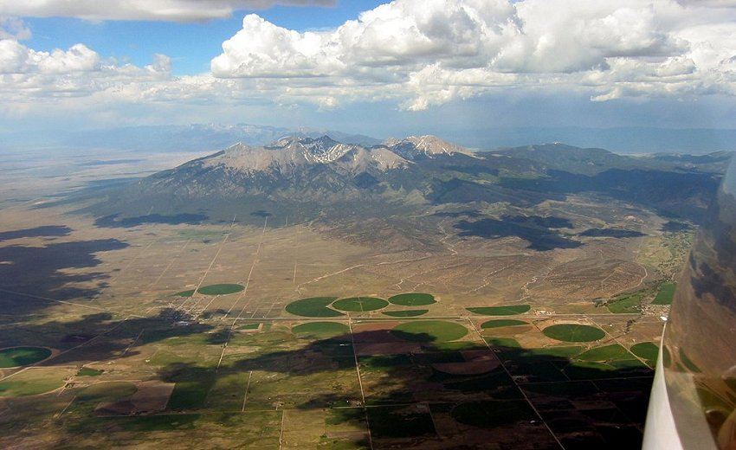
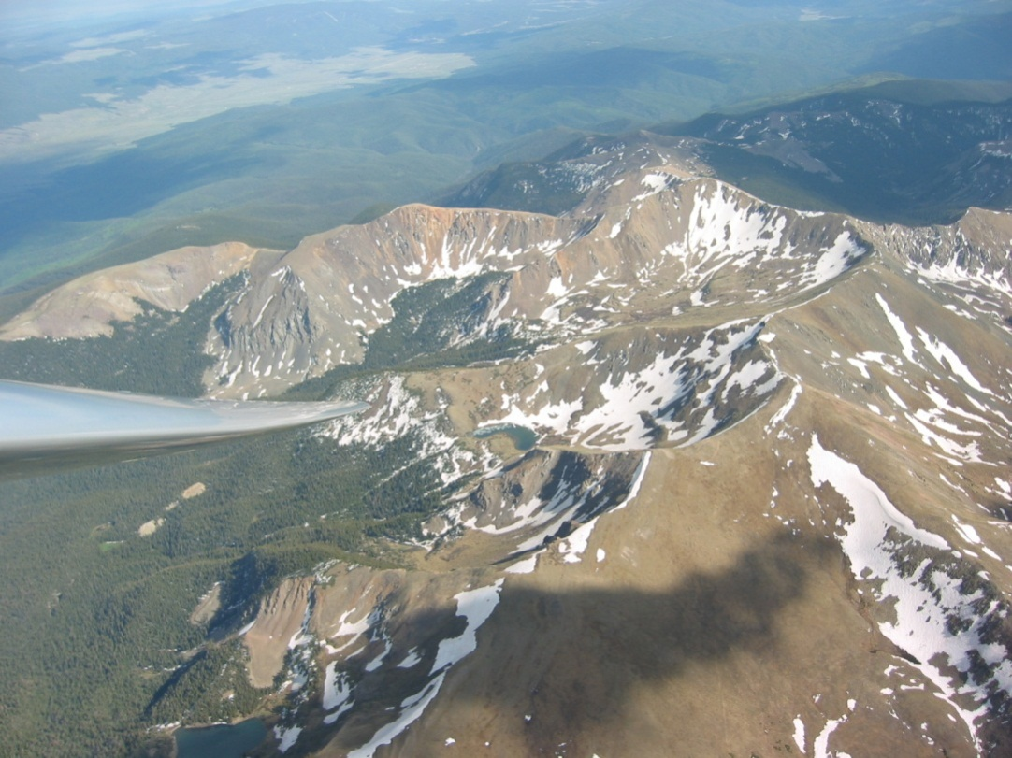
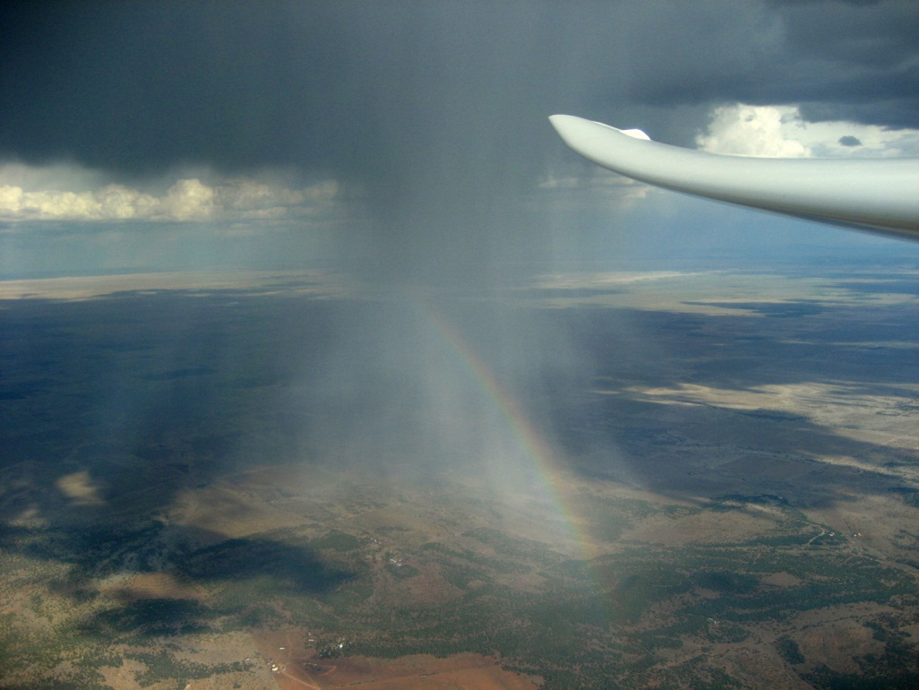
Thanks for listening! More info: brian.resor@gmail.com

Slide 27
Backup slides

Slide 28
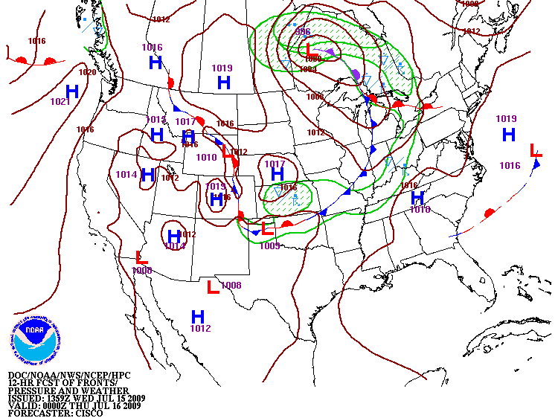
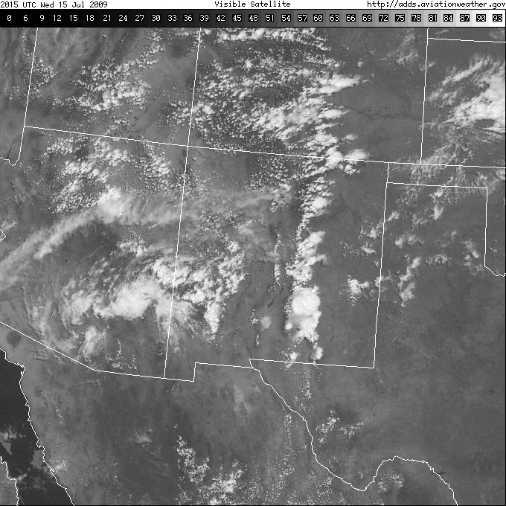
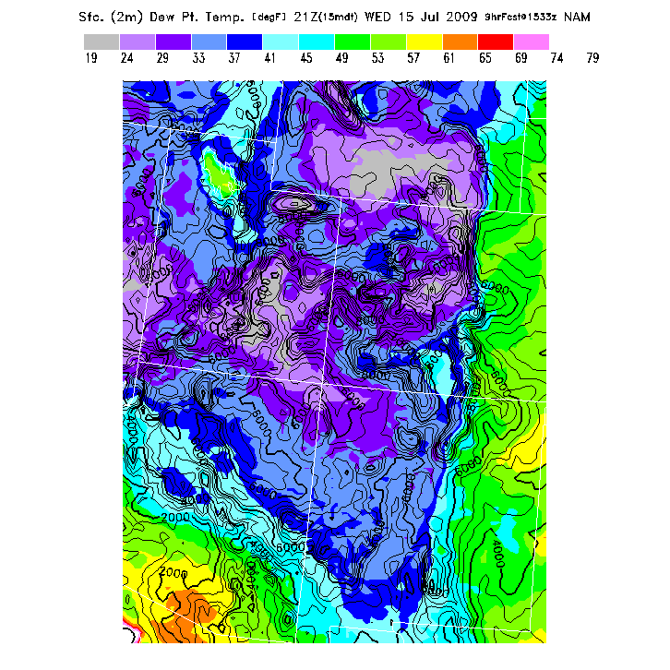
Dryline Convergence

Slide 29
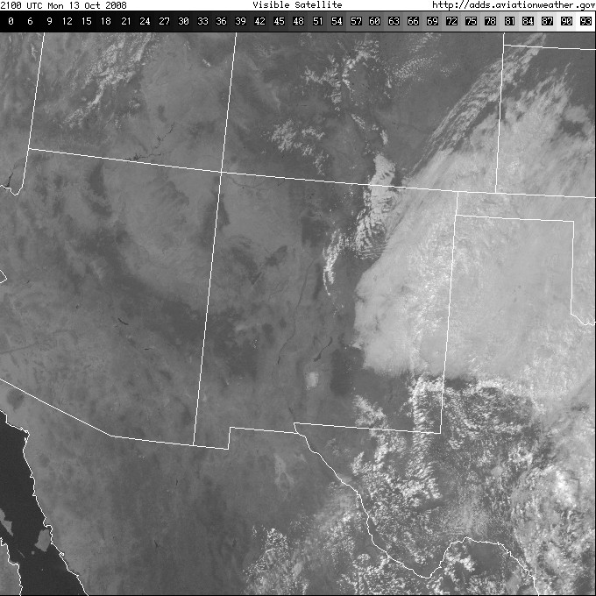
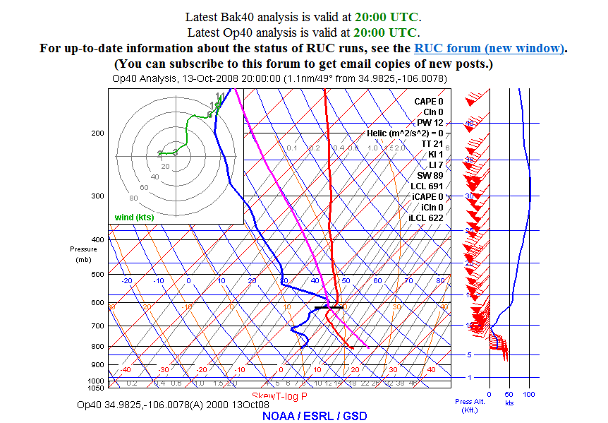
Convergence on the Move in the Estancia Valley

Slide 30
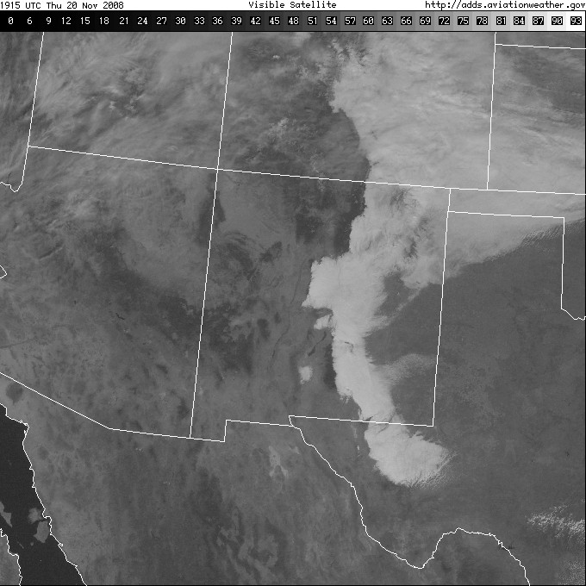
Not a good soaring day

Slide 31
